Slide 1

Introduction to Software Engineering By Dr. Praveen Kantha

Slide 2
What is Software Engineering ?
The term software engineering is the product of two words, software, and engineering.
The software is a collection of integrated programs.
Engineering is the application of scientific and practical
knowledge to invent, design, build, maintain, and improve
frameworks, processes, etc.

Slide 3
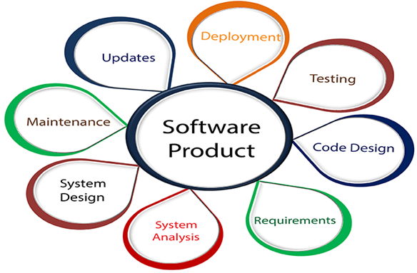
Software Engineering is an engineering branch related to the evolution of software product using well-defined scientific principles, techniques, and procedures. The result of software engineering is an effective and reliable software product.

Slide 4
Characteristics of software in software engineering:
Software is developed or engineered; it is not manufactured in the classical sense:
Although some similarities exist between software development and hardware manufacturing, few activities are fundamentally different.
The software doesn’t “wear out.”:
There are no software spare parts.
When a hardware component wears out, it is replaced by a spare part.
The software continues to be custom-built:
A software part should be planned and carried out with the goal that it tends to be reused in various projects.

Slide 5
THE EVOLVING ROLE OF SOFTWARE
Today, software takes on a dual role.
It is a product and, at the same time, the vehicle for delivering a product.
As a product, it delivers the computing potential embodied by computer hardware. Whether it resides within a mobile phone or operates inside a mainframe computer, software is an information transformer.
As the vehicle used to deliver the product, software acts as the basis for the control of the computer (operating systems), the communication of information (networks), and the creation and control other programs (software tools and environments).

Slide 6
Changing Nature of Software:
The nature of software has changed a lot over the years.
System software: Infrastructure software come under this category like compilers, operating systems, editors, drivers, etc. Basically system software is a collection of programs to provide service to other programs.
Real time software: These software are used to monitor, control and analyze real world events as they occur. An example may be software required for weather forecasting. Such software will gather and process the status of temperature, humidity and other environmental parameters to forecast the weather.

Slide 7
3. Embedded software: This type of software is placed in “Read-Only- Memory (ROM)” of the product and control the various functions of the product. The product could be an aircraft, automobile, security system, signaling system, control unit of power plants, etc. he embedded software handles hardware components and is also termed as intelligent software .
4. Business software : This is the largest application area. The software designed to process business applications is called business software. Business software could be payroll, file monitoring system, employee management, account management. It may also be a data warehousing tool which helps us to take decisions based on available data. Management information system, enterprise resource planning (ERP) and such other software are popular examples of business software.

Slide 8
5. Personal computer software: The software used in personal computers are covered in this category. Examples are word processors, computer graphics, multimedia and animating tools, database management, computer games etc. This is a very upcoming area and many big organisations are concentrating their effort here due to large customer base.

